Slide 1

Future Data Scientist
(Fudasci)
Logistic Regression Model on Bank Credit Card
Presented by-
Prannoy
Parth Saxena
Prashanth Reddy
Priti Chauhan
Pranav Patil
Sonam
Naveen Mechu

Slide 2


Goal and data description
Goal
1. The major goal of this project is to use all possible factors to predict data on customers
to find who will default in next month.
2. To find out whether the clients are able to pay their next month credit.
3. Identify potential customers for bank who can settle their credit balance.
Data Description
Data set have 25 variables and 30000 observations.
Default_Payment is dependent variable.
Independent Variables
Categorical variables | Gender, Academic qualification, Marital, Repayment status
Continuous variables | Age_years, Bill_Amount, Previous_Payment

Slide 3
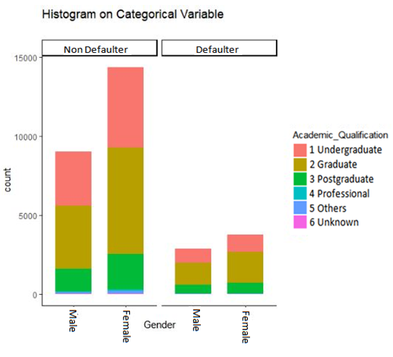
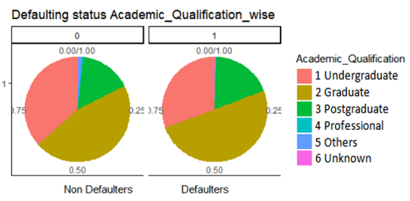
Relationship of Default with Gender and Education
1. Bar plot shows frequency wise relationship of defaulters/Non-defaulters with gender and
Academic_qualification whereas Pie chart shows proportion wise.
2. Total no of male defaulters are 2873 out of total 11888 and female defaulters are 3763 out of
total 18112.
3. Pie charts shows Graduate do more defaults i.e. 50 defaulters are graduate. Undergraduates
do less default than Graduates.

Slide 4
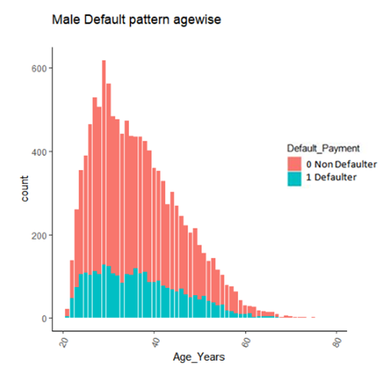
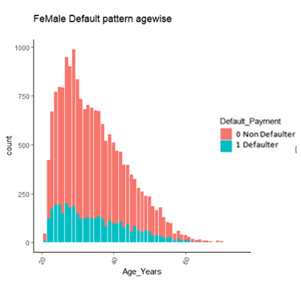
Comparison of defaulters with Age and Gender
1. Default_Payment wise bar plot of Age shows relation of Defaulters and total creditors.
2. Shows in females rate of default is maximum from 20 to 25 which decreases rapidly after that/
3. Rate of default in male is almost constant upto 40.

Slide 5
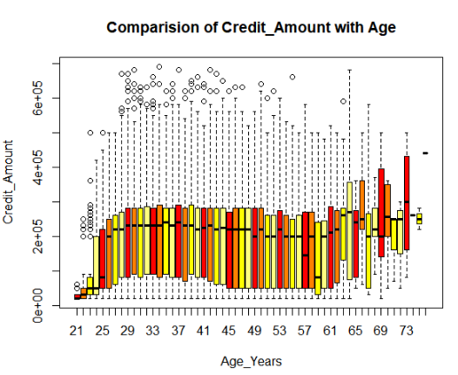
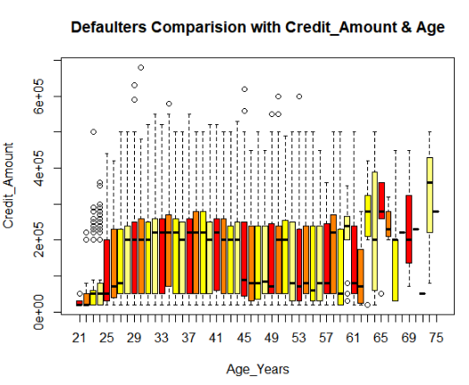
comparison of defaulters Age and credit amount wise
*NOTE- There were 3 extreme outliers in Credit_Amount which are excluded during plotting
of above plot to get better insight of data
1. Boxplot between Age and Credit amount shows credit amount is almost flatter among age groups.
2. Shows from 45 to 60 credit amount is decreases and above again increases.

Slide 6
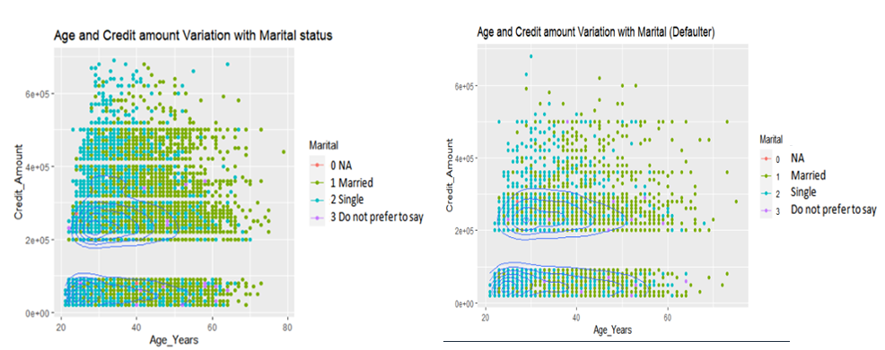
comparison of Age, Credit amount, Marital Status
First Scatterplot shows all payment status where as second Scatterplot is of only defaulters.
Rate of default with higher credit amount is comparatively less.
Shows after 30 no unmarried decreases that’s in general but ratio of default is decreases
Comparatively less.

Slide 7
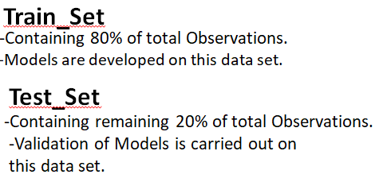


Data Processing & Model Selection
Added two new Variables-
Total_Payment(From Jan to Jun)
Total_Bill_Amount( From Jan to Jun)
Model 1
Model 2
Dependent variable | Independent Variable
Default Payment | 1. Repayment_Status_Jan
 | 2. Repayment_Status_March
 | 3. Repayment_Status_May
 | 4. Repayment_Status_June
 | 5. Previous_Payment_Jan
 | 6. Previous_Payment_Feb
Dependent variable | Independent Variable
Default Payment | 1. Credit _Amount
 | 2. Age_Years
 | 3. Repayment_Status_Jan
 | 4. Repayment_Status_June
 | 5. Previous_Payment_Jan

Slide 8
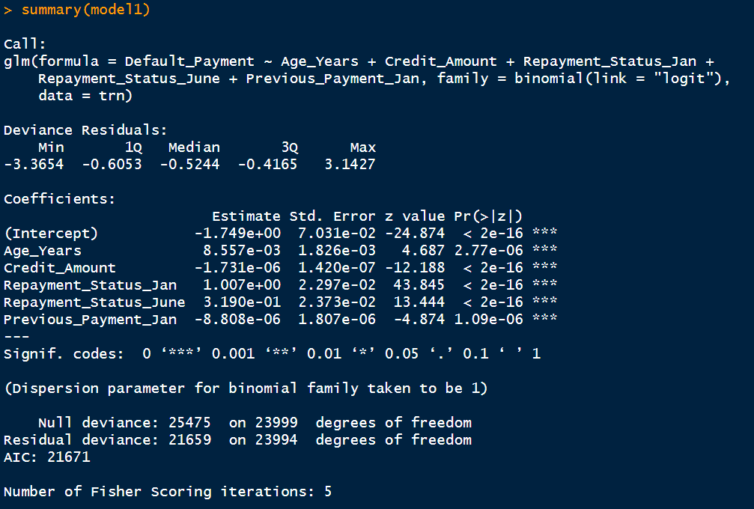
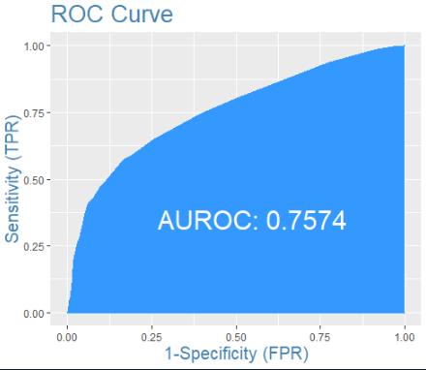


Prediction using Model 1

Slide 9
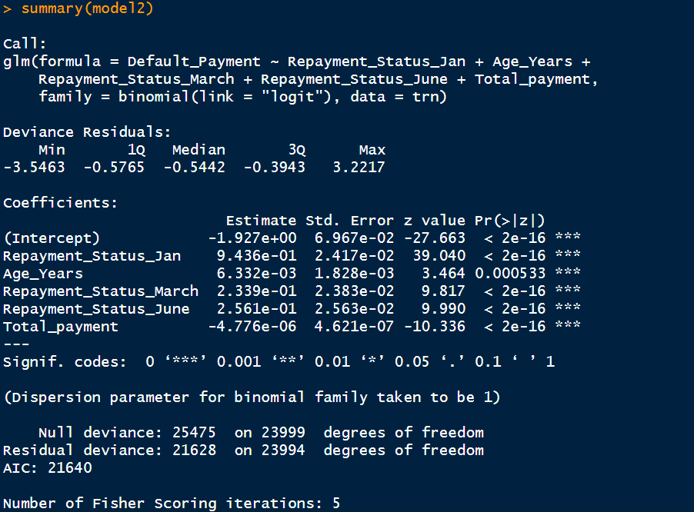
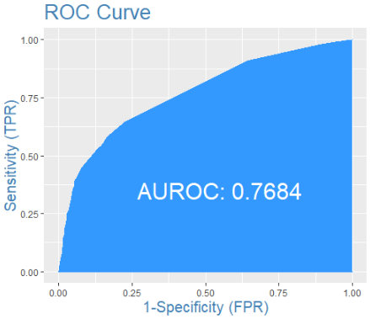


Prediction using Model 2

Slide 10


